Slide 1
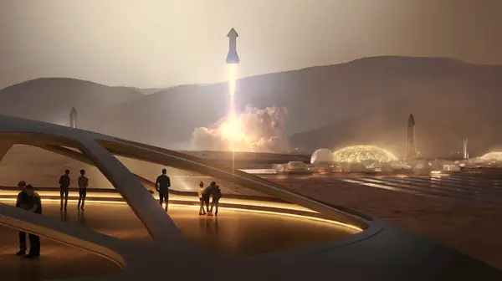
AKASHA PARYATANAM

Slide 2
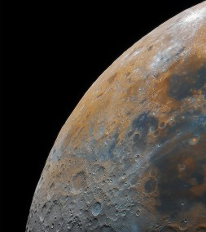
ABOUT US
Welcome to Akasha Paryatanam, your gateway to the stars and beyond. As an Indian space tourism agency, we are dedicated to making the cosmos accessible to everyone. With a passion for exploration and a commitment to excellence, we offer unparalleled experiences that transcend Earth's boundaries.
Our team of space enthusiasts, engineers, and experts collaborates tirelessly to curate unforgettable journeys. From the mystical Moon to the majestic gas giants Saturn and Jupiter, and the enigmatic Red Planet Mars, we bring the universe closer to you, all while ensuring your safety and comfort.

Slide 3

TRAVEL PACKAGES OFFERED
Mars Expedition
Lunar Getaway
Saturn's Splendor
Jupiter Odyssey
Galactic Grand Odyssey: Mars, Moon, Saturn, and Jupiter Expedition

Slide 4
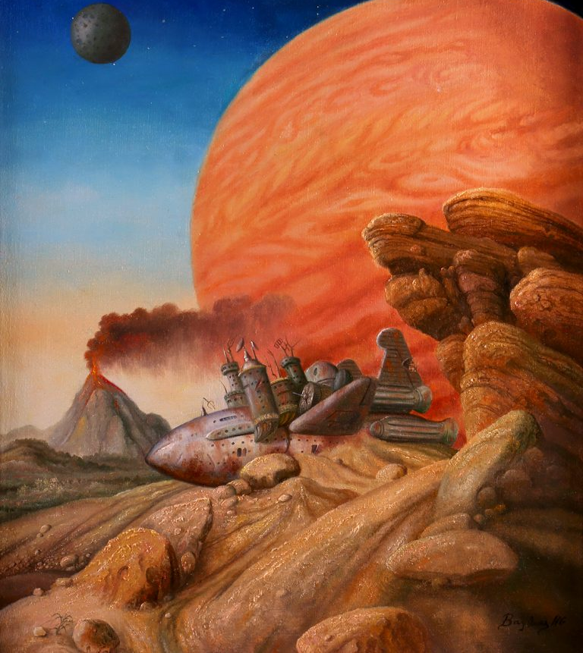
MARS EXPEDITION
The Mars Expedition with Akasha Paryatanam offers a once-in-a-lifetime opportunity to journey to the Red Planet. You'll board a state-of-the-art spacecraft equipped for comfort and safety on this interplanetary adventure. Our expert crew will guide you through the cosmos, providing insights into Mars' mysteries. Upon arrival, step onto Martian soil, explore its unique landscapes, and engage in scientific experiments. Experience Earthrise from Mars, marvel at the Martian sunset, and gain a profound understanding of our neighboring planet. Join us on this historic expedition, where the boundaries of human exploration are pushed, and the wonders of Mars await your discovery.

Slide 5
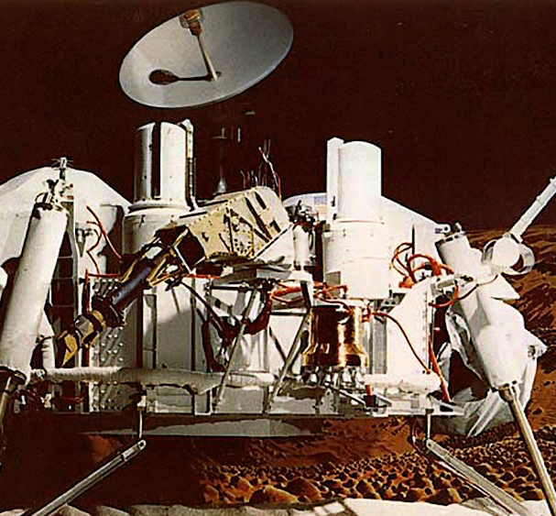
Mars Expedition Itinerary
Day 1: Departure from Earth
Departure from Earth on our spacecraft, equipped with state-of-the-art amenities.
Orientation and safety briefing by our expert crew.
Enjoy space cuisine while gazing at the stars.
Day 2-3: Transit to Mars
In-flight educational sessions about Mars, its history, and significance.
Opportunity for stargazing and celestial observation.
Day 4: Arrival at Mars
Witness the Red Planet's approach and descent.
Land at the historic landing site of the Viking 1 mission.
Day 5-7: Viking 1 Landing Site Exploration
EVA (extravehicular activity) on Martian surface.
Explore the Viking 1 landing site, collect samples, and conduct experiments.
Camping on Mars for a unique experience.

Slide 6
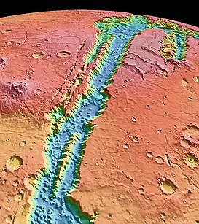
Day 8: Departure to Valles Marineris
Launch from Viking 1 site towards Valles Marineris.
Stunning views of Martian landscapes during transit.
Day 9-11: Valles Marineris Exploration
Land near Valles Marineris, the largest canyon in the solar system.
Conduct geological studies, rover excursions, and breathtaking hikes
along the Martian canyon's rim.
Day 12: Olympus Mons Expedition
Travel to the Olympus Mons region, the largest volcano in the solar
system.
Explore the volcano's base and surrounding terrain.
Day 13-15: Olympus Mons Summit
Ascend Olympus Mons with the support of our experienced guides.
Reach the summit for panoramic views of Mars and the cosmos.
Study volcanic activity and Martian geology.
Day 16: Return to Earth
Departure from Mars and initiate the journey back to Earth.
Reflect on your Mars adventure during the return trip.
Day 17-18: Transit Back to Earth
Debriefing and sharing of experiences with fellow travelers.
Final stargazing and celestial observations.
Day 19: Arrival Back on Earth
Reentry and landing on Earth, marking the end of your epic Mars
Expedition.

Slide 7
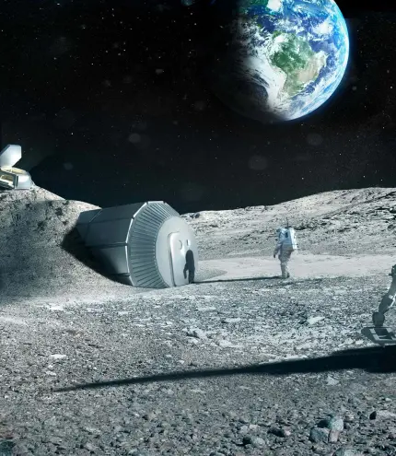
Lunar Getaway with Akasha Paryatanam
Embark on a celestial journey like no other with our Lunar Getaway experience. Depart Earth aboard our cutting-edge spacecraft, setting a course for the Moon. As you approach our lunar neighbor, witness the awe-inspiring Earthrise from the Moon's surface—a sight few have ever seen.
Upon landing, step onto lunar soil and become part of the exclusive club of moonwalkers. Explore the Moon's rugged terrain, collecting lunar samples and conducting experiments. Our expert guides will offer insights into lunar history and geology. Spend nights beneath the stars, gazing at the Earth from the tranquility of the Moon.
Whether you're an aspiring astronaut, a space enthusiast, or simply curious about our celestial neighbor, our Lunar Getaway promises an unforgettable adventure beyond the bounds of Earth, where the wonders of the Moon await your discovery.

Slide 8

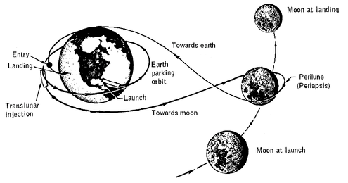
Lunar Getaway Itinerary
Day 1: Departure from Earth
Depart Earth aboard our spacecraft, equipped with modern amenities for comfort and safety.
Orientation and safety briefing by our expert lunar crew.
Enjoy space cuisine while getting to know your fellow travelers.
Day 2-3: Transit to the Moon
Educational sessions about lunar history and significance.
Opportunity for stargazing and celestial observation.
Day 4: Lunar Arrival and Earthrise
Witness the breathtaking Earthrise from the lunar surface.
Land at a designated lunar site, a historic location where the Apollo missions once explored.
Day 5-7: Lunar Exploration
EVA (extravehicular activity) on the lunar surface.
Explore the historic landing site, collect lunar samples, and conduct experiments.
Enjoy lunar camping for a truly unique experience.

Slide 9
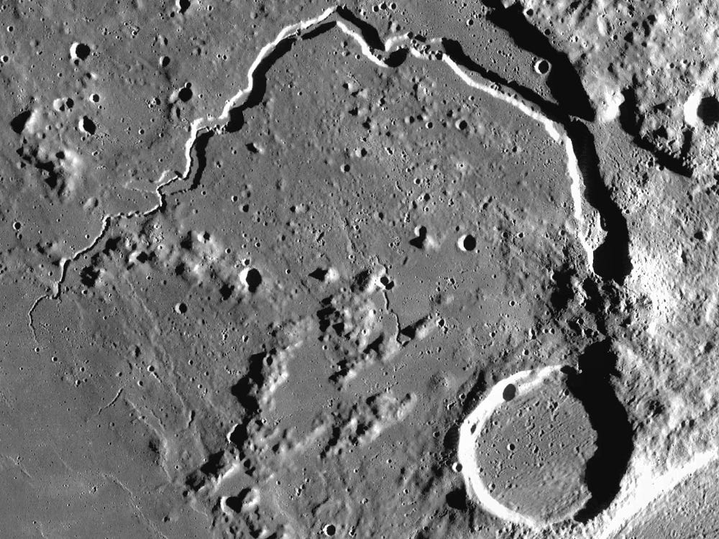
Day 8: Departure to Lunar Canyon
Launch from the Apollo landing site towards a lunar canyon.
Enjoy panoramic views of the lunar landscape during transit.
Day 9-11: Lunar Canyon Exploration
Land near a lunar canyon and descend into its depths.
Conduct geological studies, rover excursions, and lunar hikes along the canyon rim.
Day 12: Lunar Volcano Visit
Travel to a region near a dormant lunar volcano.
Explore the volcanic terrain and study lunar geology.
Day 13-15: Lunar Summit Ascent
Ascend the lunar volcano with the support of our experienced guides.
Reach the summit for unparalleled views of the Moon and Earth.
Conduct scientific research on lunar volcanic activity.
Day 16: Return to Earth
Depart from the lunar surface and initiate the journey back to Earth.
Reflect on your lunar adventure during the return trip.
Day 17-18: Transit Back to Earth
Debriefing and sharing of experiences with fellow travelers.
Final stargazing and celestial observations.
Day 19: Arrival Back on Earth
Reentry and landing on Earth, marking the end of your extraordinary Lunar Getaway.

Slide 10
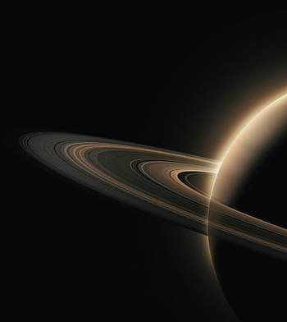
Saturn's Splendor with Akasha Paryatanam
Prepare to be captivated by the majesty of the solar system's jewel—Saturn. Our Saturn's Splendor expedition offers a celestial journey unlike any other. Depart Earth on our state-of-the-art spacecraft and venture deep into the realm of this gas giant.
Saturn's breathtaking rings and enigmatic moons await your exploration. Witness the planet's mesmerizing storms and the grandeur of its iconic rings up close. Our expert guides will provide insights into Saturn's history and scientific significance as you traverse its vast celestial canvas.
Saturn's Splendor promises an unforgettable cosmic odyssey, where you'll gain a profound understanding of the mysteries of this magnificent giant. Whether you're a space enthusiast, an aspiring astronomer, or simply in search of cosmic wonder, Saturn's Splendor will leave you in awe of the celestial beauty that exists beyond our Earthly realm.

Slide 11
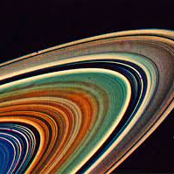
Saturn's Splendor Itinerary
Day 1: Departure from Earth
Depart Earth aboard our advanced spacecraft, designed for comfort and safety during interplanetary travel.
Orientation and safety briefing by our expert Saturnian crew.
Enjoy space cuisine and get to know fellow travelers.
Day 2-3: Transit to Saturn
Educational sessions about Saturn, its rings, and moons.
Opportunity for stargazing and celestial observation.
Day 4: Arrival at Saturn
Witness Saturn's breathtaking beauty as the gas giant comes into view.
Begin the descent into Saturn's orbit.
Day 5-7: Exploration of Saturn's Rings
Conduct close flybys of Saturn's iconic rings.
Study ring composition and origin through specialized equipment.
Photograph the rings in their full splendor.

Slide 12
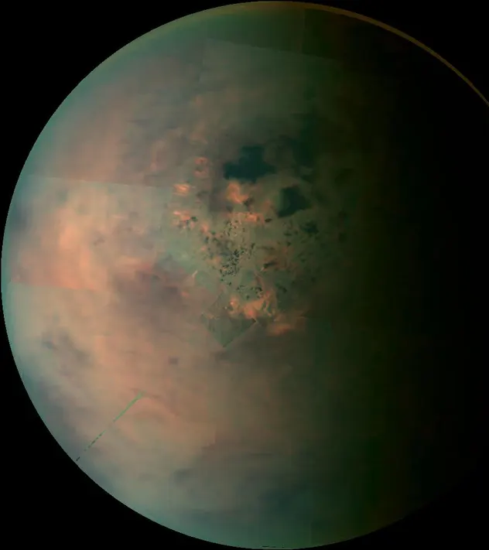
Day 8: Titan Landing
Descend to Titan, Saturn's largest moon.
Explore its unique atmosphere and terrain.
Investigate the potential for life on this intriguing moon.
Day 9-11: Enceladus Exploration
Journey to Enceladus, a moon with icy geysers.
Fly through the plumes and collect samples for analysis.
Investigate the possibility of subsurface oceans.
Day 12: Cassini Gap Adventure
Navigate through the Cassini Division, a gap in Saturn's rings.
Experience the stunning view as the rings part around you.
Day 13-15: Saturn's Storm Chasing
Approach Saturn's Great Red Spot and other massive storms.
Collect data on atmospheric conditions and storm behavior.
Witness the awe-inspiring scale of Saturn's tempests.
Day 16: Return to Earth
Depart Saturn and initiate the journey back to Earth.
Reflect on your Saturnian adventure during the return trip.
Day 17-18: Transit Back to Earth
Debriefing and sharing of experiences with fellow travelers.
Final stargazing and celestial observations.
Day 19: Arrival Back on Earth
Reentry and landing on Earth, marking the end of your extraordinary Saturn's Splendor expedition.

Slide 13
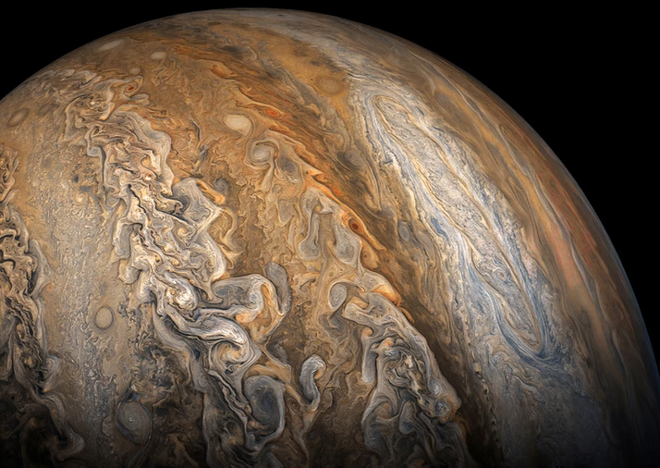
Jupiter's Odyssey with Akasha Paryatanam
Prepare for an epic odyssey into the realm of the largest planet in our solar system—Jupiter. Our Jupiter's Odyssey expedition promises awe-inspiring adventures amid swirling storms and moon-filled skies. Depart Earth aboard our cutting-edge spacecraft and journey to this gas giant.
Explore Jupiter's tempestuous atmosphere, study its iconic Great Red Spot, and marvel at the dance of its Galilean moons. Our expert guides will provide insights into Jupiter's scientific significance and captivating mysteries.
Jupiter's Odyssey offers an interplanetary adventure of epic proportions, where you'll gain a profound appreciation for the cosmic wonders of this colossal world. Whether you're a space enthusiast, an aspiring astronomer, or simply curious about the grandeur of the cosmos, Jupiter's Odyssey will leave you in awe of the celestial splendor that awaits beyond Earth's boundaries.

Slide 14
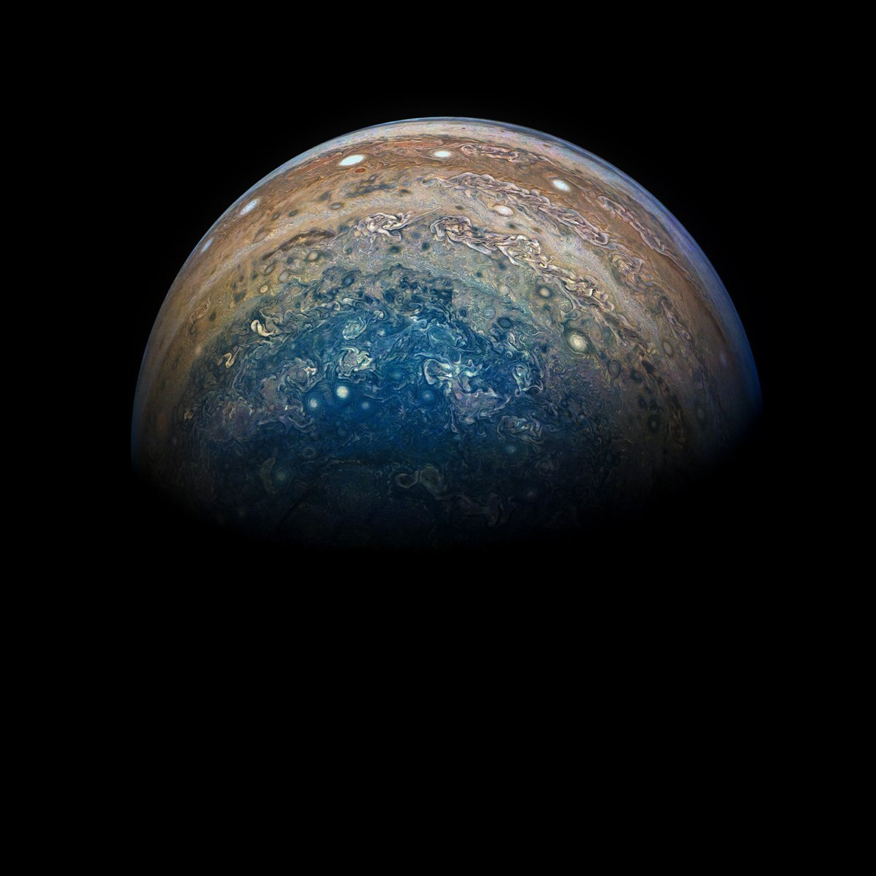
Jupiter's Odyssey Itinerary
Day 1: Departure from Earth
Depart Earth aboard our advanced spacecraft, designed for comfort and safety during interplanetary travel.
Orientation and safety briefing by our expert Jupiterian crew.
Enjoy space cuisine and get to know fellow travelers.
Day 2-3: Transit to Jupiter
Educational sessions about Jupiter, its storms, and moons.
Opportunity for stargazing and celestial observation.
Day 4: Arrival at Jupiter
Witness the colossal gas giant as it comes into view.
Begin the descent into Jupiter's atmosphere.
Day 5-7: Atmospheric Research
Dive into Jupiter's tumultuous atmosphere, studying its composition and weather patterns.
Experience the thrill of turbulent storms and capture scientific data.

Slide 15
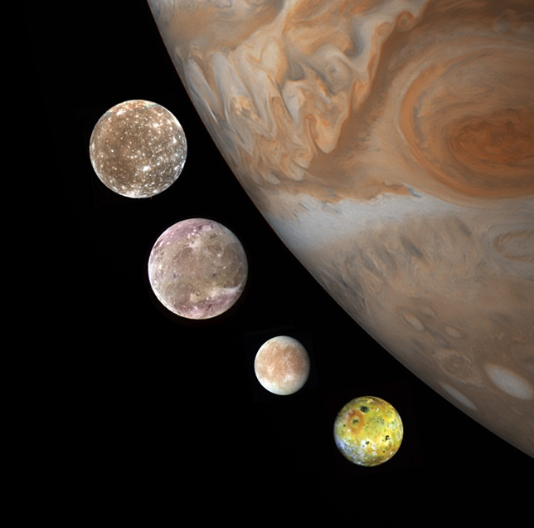
Day 8: Great Red Spot Exploration
Approach Jupiter's iconic Great Red Spot, a massive storm system.
Collect data and capture breathtaking imagery of this celestial phenomenon.
Day 9-11: Galilean Moon Adventure
Visit the Galilean moons—Io, Europa, Ganymede, and Callisto.
Conduct surface landings and exploration on select moons.
Study geological features, potential habitability, and unique characteristics.
Day 12: Jupiter's Ring Flyby
Fly through Jupiter's faint ring system, capturing stunning views and scientific data.
Day 13-15: Inner Moons and Rings
Explore Jupiter's inner moons, such as Amalthea and Thebe.
Study ring dynamics, composition, and origin.
Day 16: Return to Earth
Depart Jupiter and initiate the journey back to Earth.
Reflect on your Jupiterian odyssey during the return trip.
Day 17-18: Transit Back to Earth
Debriefing and sharing of experiences with fellow travelers.
Final stargazing and celestial observations.
Day 19: Arrival Back on Earth
Reentry and landing on Earth, marking the end of your extraordinary Jupiter's Odyssey.

Slide 16
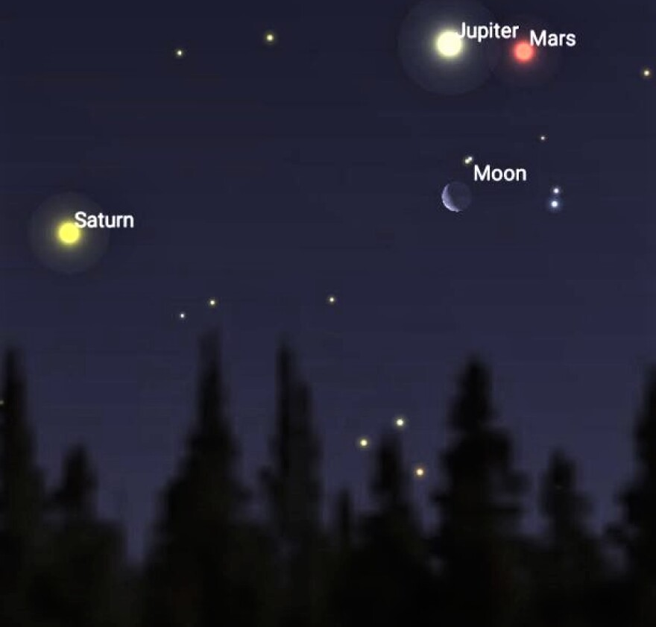
Galactic Grand Odyssey with Akasha Paryatanam
Experience the ultimate cosmic adventure with our Galactic Grand Odyssey. This extraordinary journey combines visits to Mars, the Moon, Saturn, and Jupiter, offering a comprehensive exploration of our solar system's most captivating destinations. Depart Earth aboard our advanced spacecraft, led by a team of expert guides, and embark on a voyage that pushes the boundaries of human exploration. From the mysteries of Mars to the majestic gas giants, this grand odyssey promises awe-inspiring experiences and a profound connection to the cosmos. Whether you're a space enthusiast, an aspiring astronaut, or simply curious about the wonders of the universe, the Galactic Grand Odyssey offers an unparalleled opportunity to explore the final frontier.

Slide 17
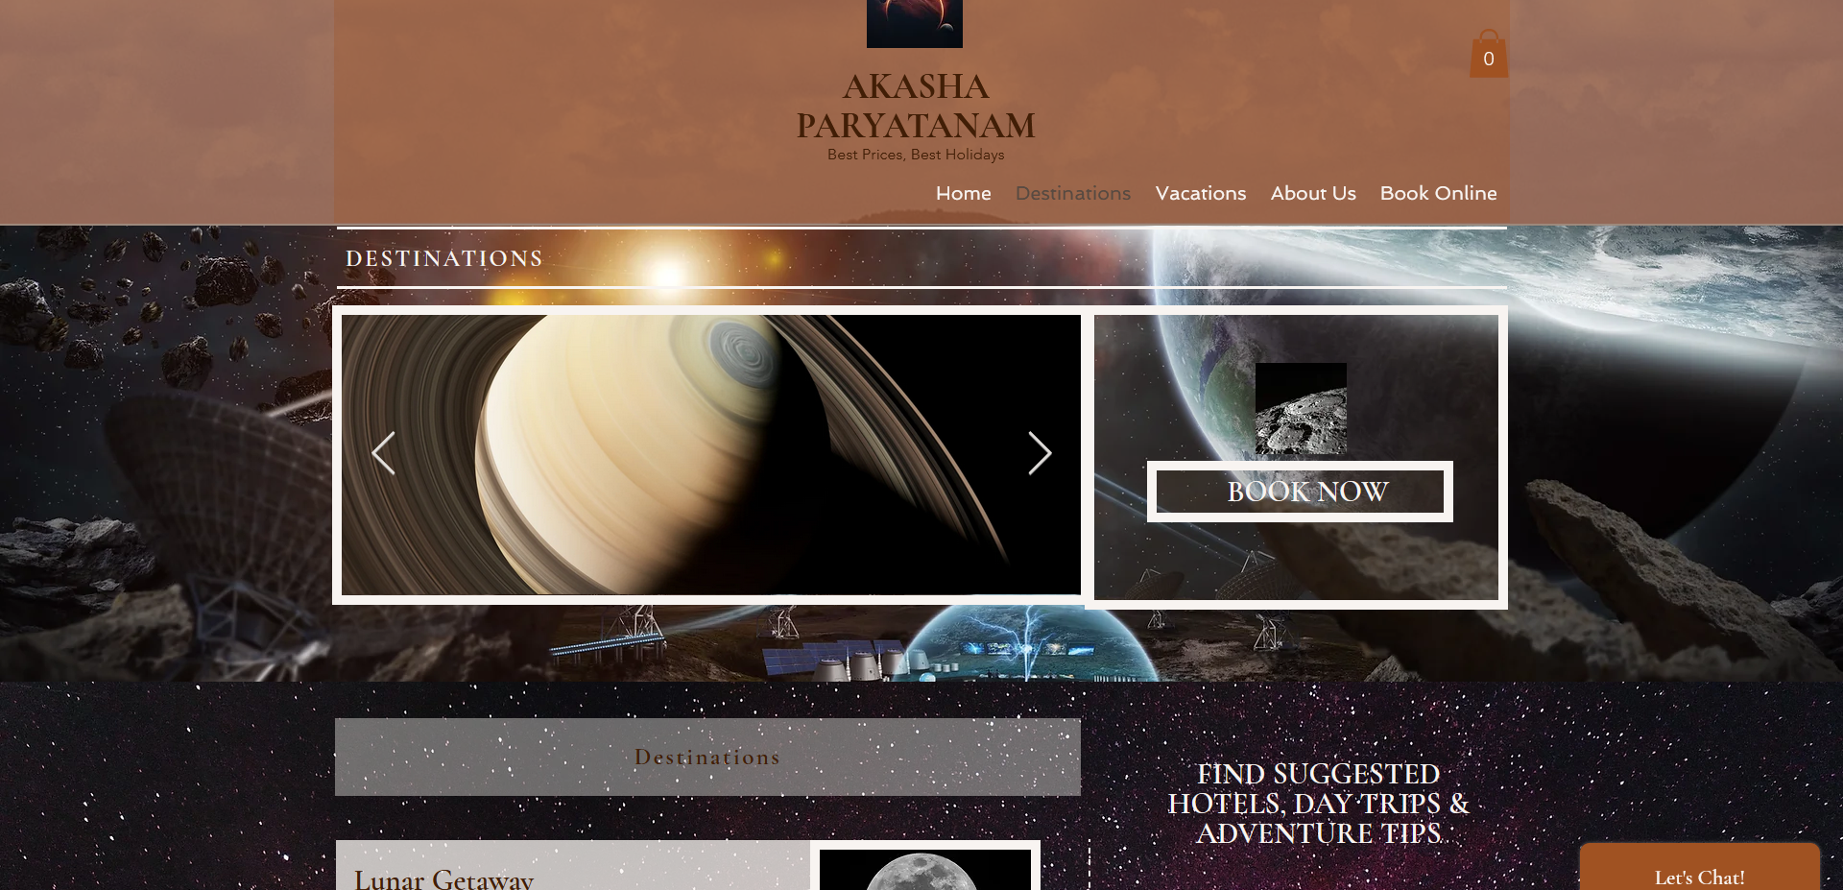
To reserve your tour tickets, please go to https://athlkmrr.wixsite.com/akashaparyatanam.

